Slide 1
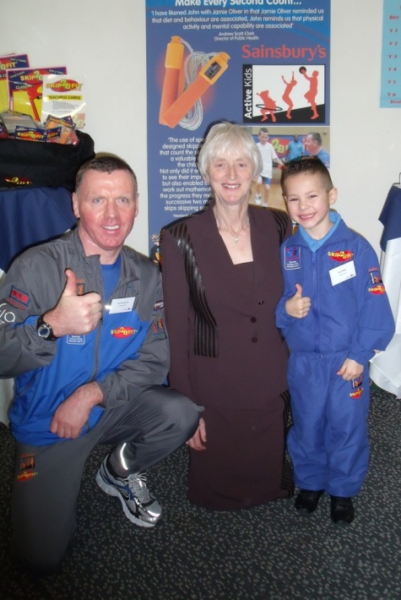

Skip2bfit
…Changing mindsets one skip at a time

Slide 2
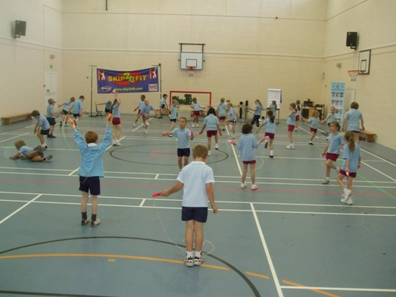
Skip2bfit –Embedding a Growth Mindset
Skip2bfit started in 2002 and has now seen over 1 Million children
Skip2Bfit skipping workshops provide totally unique workshops incorporating skipping with:
-Motivation
-Healthy eating
-Numeracy
-Physical activity
-Helping to develop a GROWTH MINDSET by giving a practical example of how you can improve with a growth mindset.

Slide 3
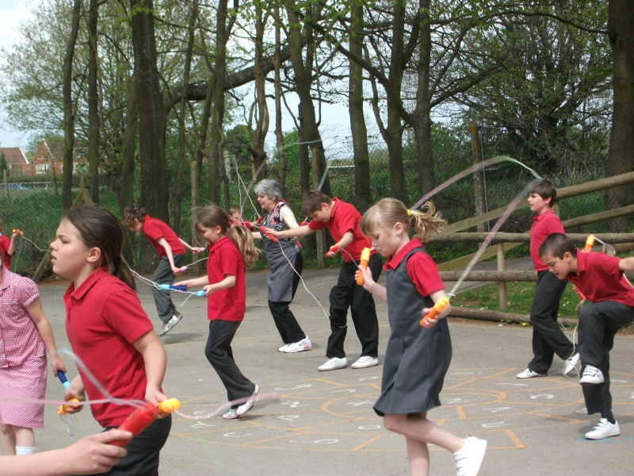
What is a Skip2bfit workshop?
All the children in the school are seen in their class groups or two classes at a time
The children are taught about the importance of exercise and healthy eating
They are shown how to skip like a boxer using three easy steps
Fresh blueberries given to all the children in the school
A 15 minute celebration assembly is held at the end of the day to hand out prizes to the top skippers and best effort

Slide 4
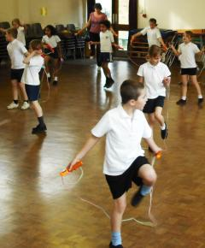
How can Skip2bfit intrinsically motivate the pupils?
The counter on the handle counts the number of skips you do in 2 minutes.
After their first skip the pupils are told they are to skip again and we want them to improve
Majority of children beat their score on the very first try. When competing against themselves they are very motivated!
We then ask them , ‘why they improved’. It is because they wanted to and if they can do this in skipping they can do it in the classroom with their other school work.

Slide 5
Skip2Bfit helps achieve improvements in the 5 key areas
​Increasing all staff’s confidence, knowledge and skills in teaching PE and sport
PE Warm up, easy to run sessions
Increasing engagement of all pupils in regular physical activity and sport​
Alternative to daily mile
Raising the profile of PE and sport across the school, to support whole school improvement​
6 week improvements, Balance, timing, coordination
Offer a broader and more equal experience of a range of sports and physical activities to all pupils​
Structured Skipping, everyone can do it, huge engagement
Increased participation in competitive sport​
Inter/Intra school competitions easily organised

Slide 6
From the Sports Premium funding announcement We’ve collated real-life working Examples of effective PE and sport premium spending to help understand ways this can be implemented
“In addition to the 2 hours of timetabled Physical Education curriculum lessons,
teachers are expected to take pupils on active breaks during the school day. These
may be “a mile a day”, class skipping rope activities (all classes have access to a
class set of ropes from our skipping workshop) or ‘active blasts’ (short periods of
physical activities that give pupils a brief break from learning to increase their focus
in class) sessions.”

Slide 7
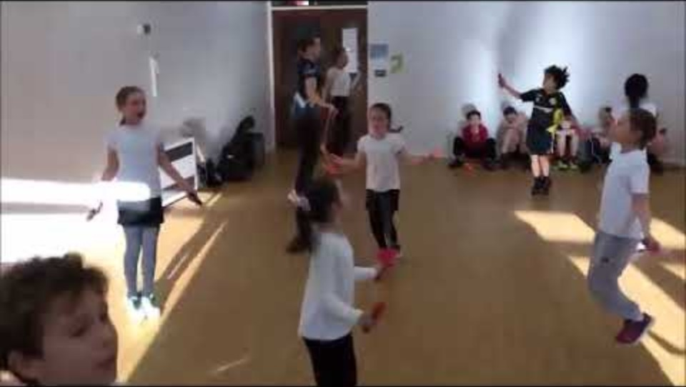
Watch the boy with glasses

Slide 8
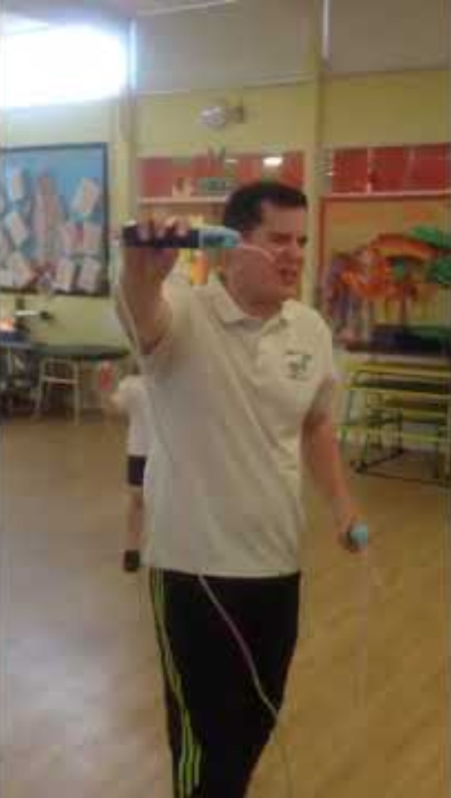
Teacher who improves!

Slide 9
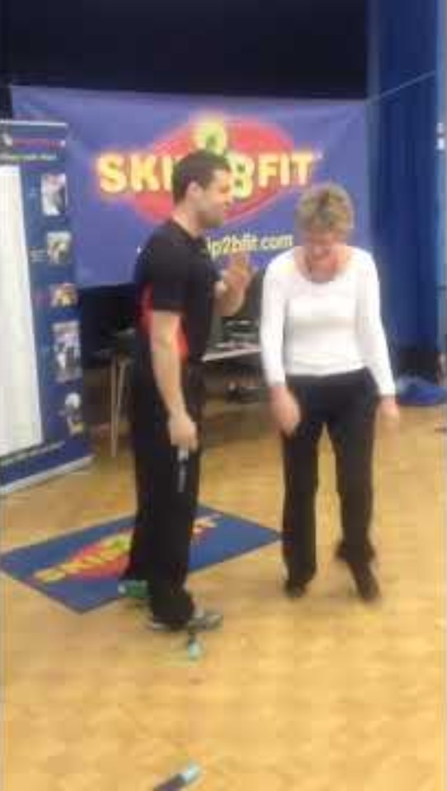
Teacher who doesn’t improve!

Slide 10
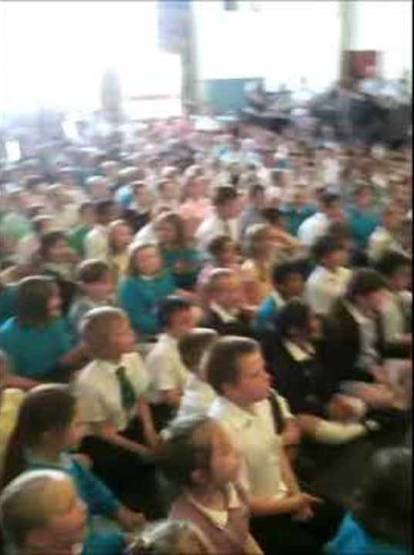
Final assembly Top Teacher Vs Top Pupil

Slide 11
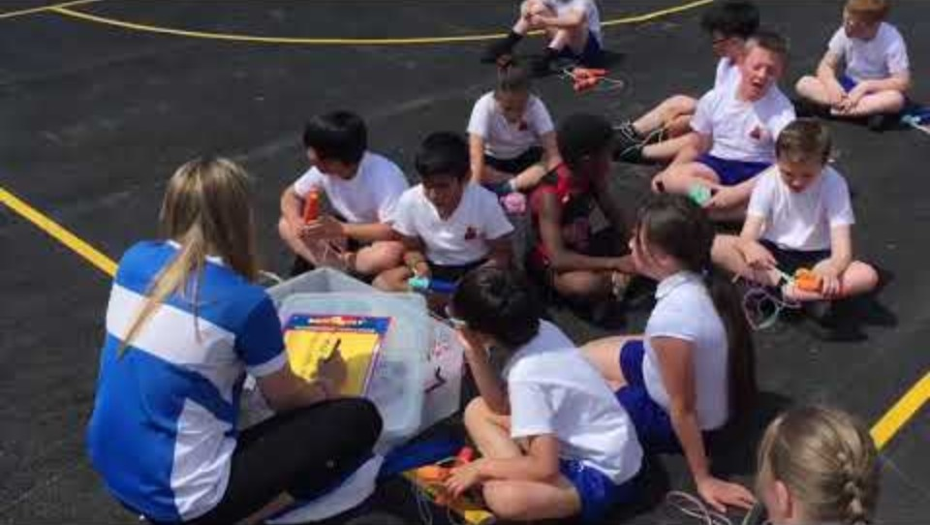

Slide 12
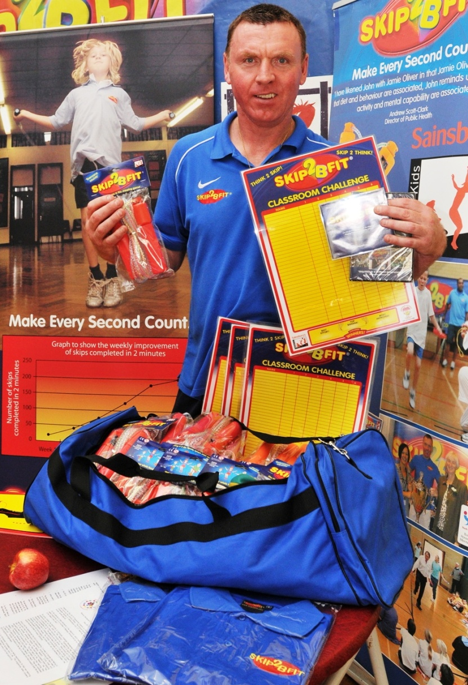
Skip2bfit offers a sustainable programme for schools by using the Skip2bfit kitbag

Slide 13
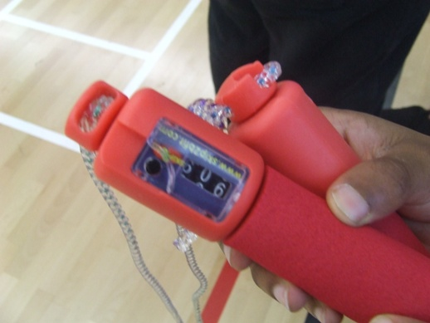
Skip2bfit motivates children to improve in all areas of their school work
“By giving children the opportunity to individually challenge themselves physically, they experience the “Yes Feeling”! Experiencing that deep, warm feeling, of knowing that you have improved through your own effort, is highly motivating.”
Heidi Taylor, Headteacher

Slide 14
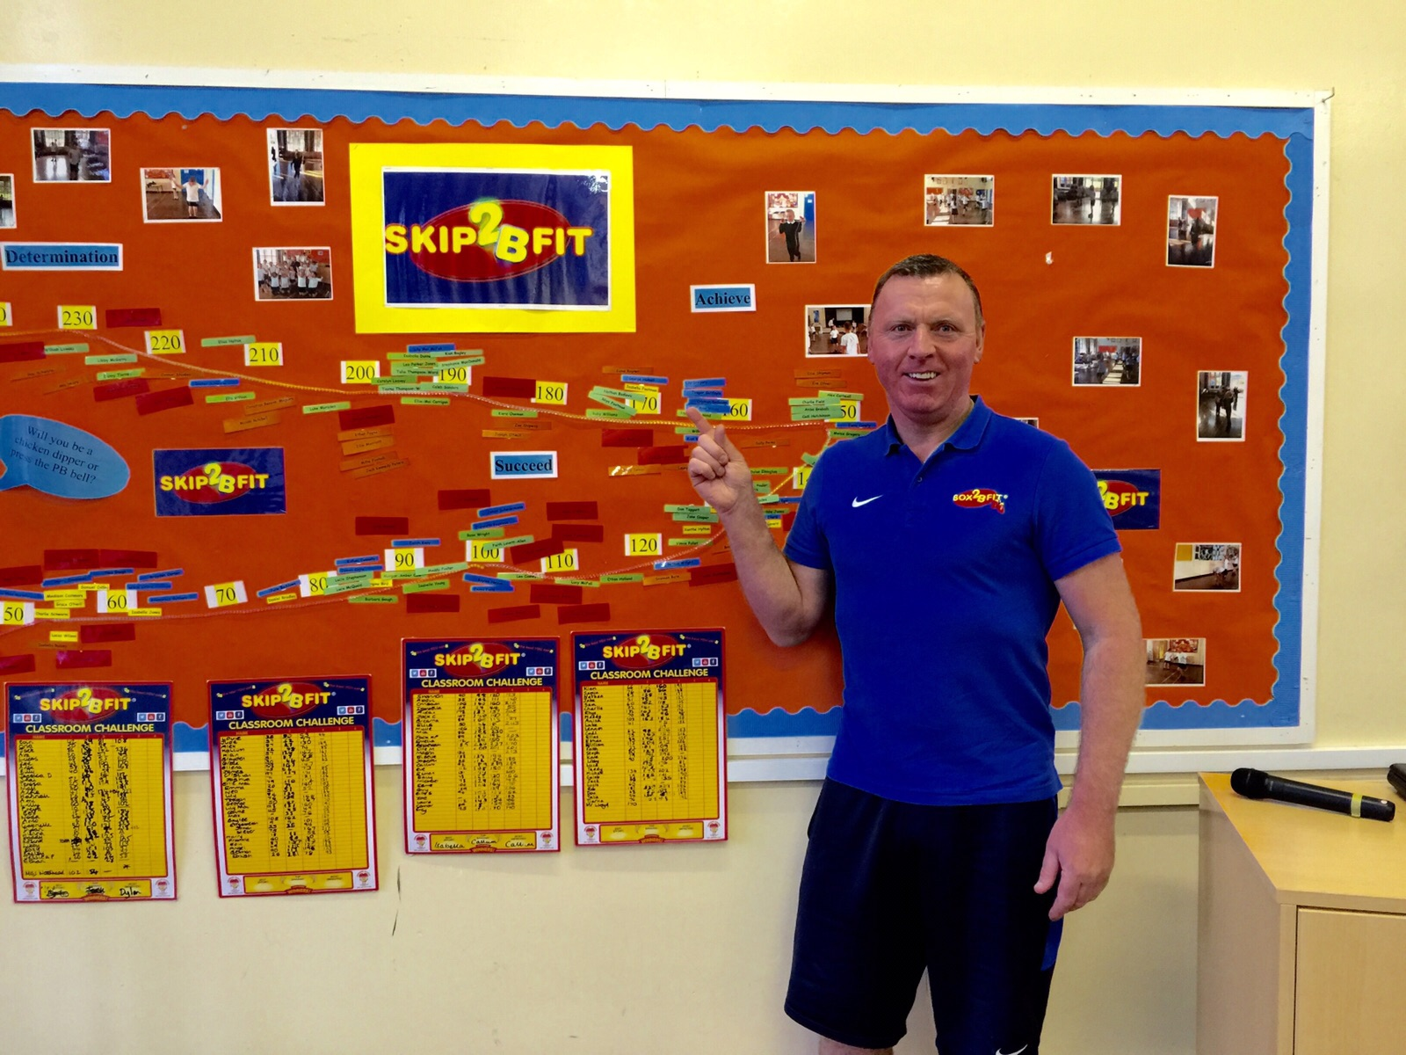

Slide 15
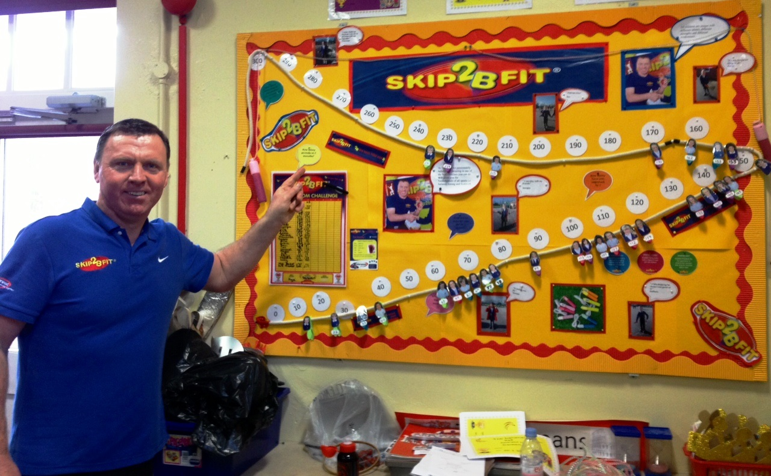

Slide 16
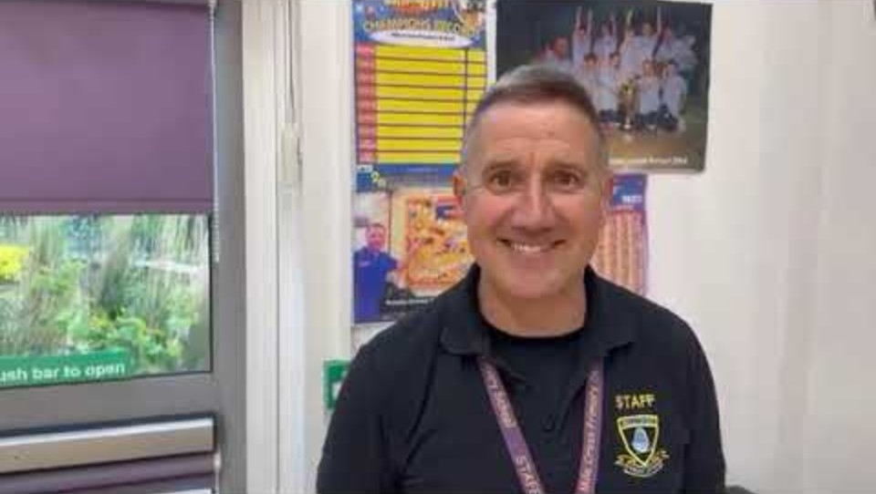

Slide 17
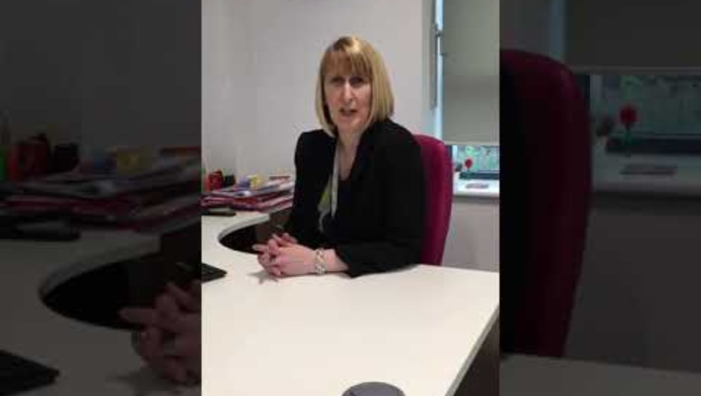
Interview with Head 6 weeks after Skip2Bfit visit

Slide 18
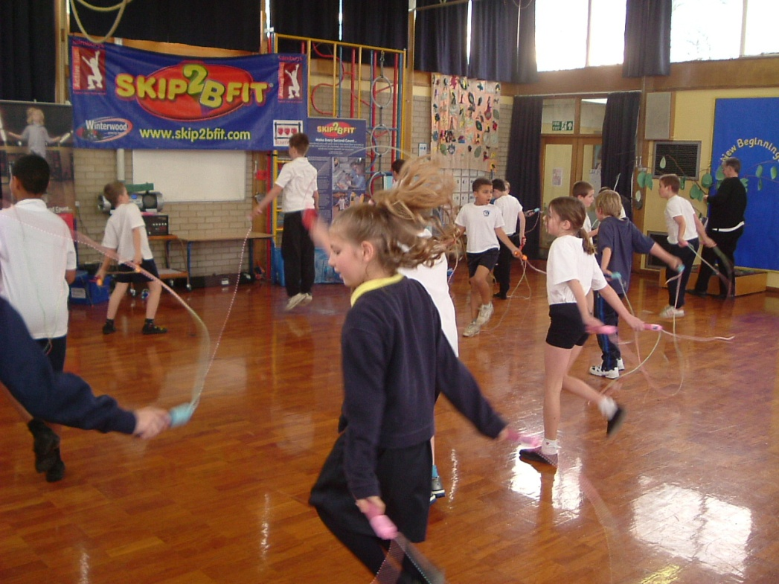
Skip2bfit Virtual Leagues
Lunchtime skipping sessions
Improved behaviour in afternoons
Improved behaviour prior to competition
No transport costs
Increased competition both inter and intra

Slide 19
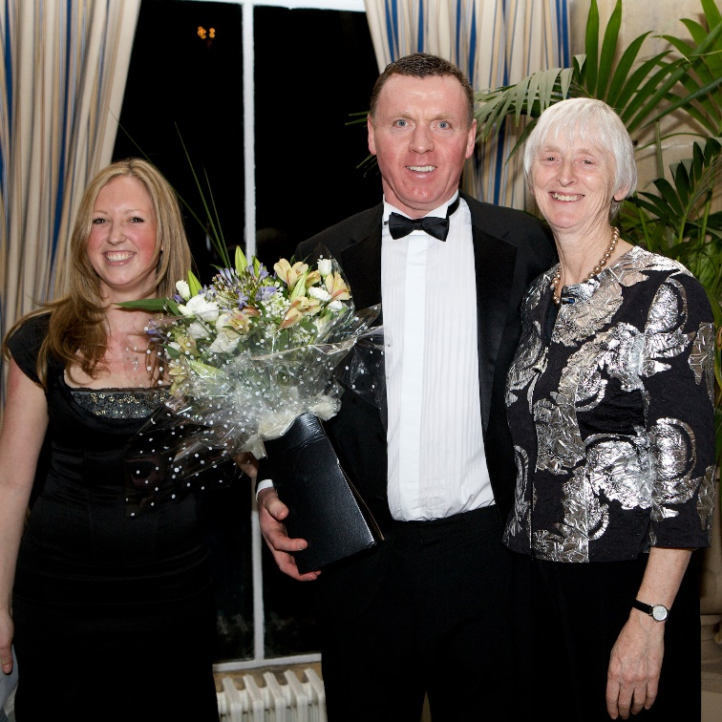
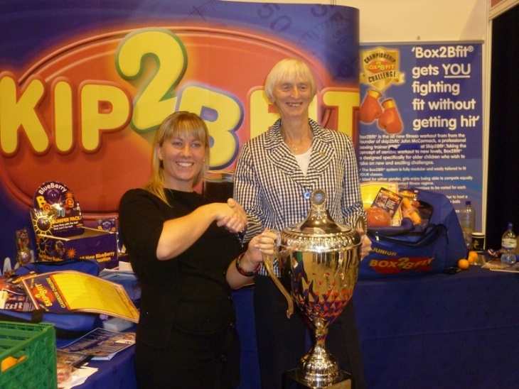
Skip2bfit was a member of the Youth Sports Trust Business Honours Club and won the Innovation Award in the year it was introduced,

Slide 20
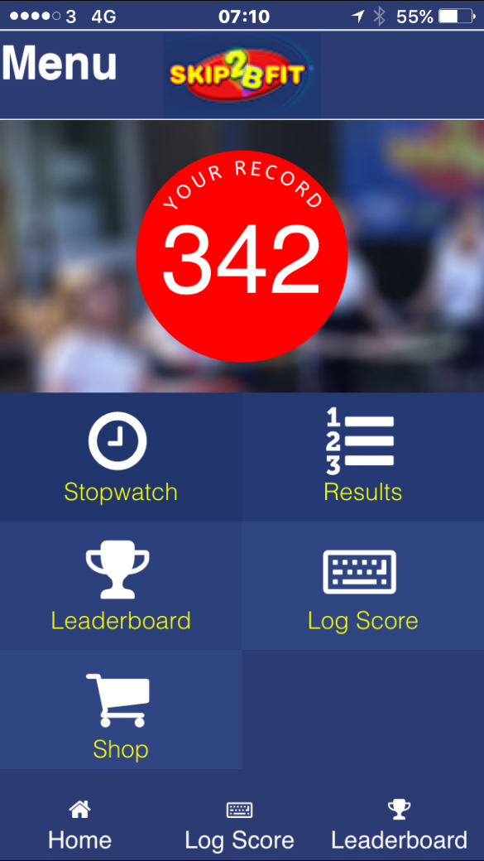


Skip2bfit is for everybody
We try to encourage the children to get their grown ups skipping and now have the FREE Skip2Bfit App with one 2 minute music track with motivating voice overs.

Slide 21

Cost of skip2bfit
One day workshop- £480 +VAT
Skip2bfit kitbag- £375 + VAT

Slide 22

Sponsored skips are very east to arrange using the skip2bfit counter rope.

